Slide 1
Enterprise Miner Introduction

Slide 2
Introduction to Modeling in Enterprise Miner (EMiner)
EMiner Models are created using diagrams
Working with EMiner is a three-step process of working with data
• First, read data (Input Data (SAS) or File Import (Other Files) Node)
• Then, run the data through a series of manipulations,
• And finally, send the data to a destination
In this course we will use EMiner mostly for data exploration, modeling, and assessment (sEmMA)
Eminer Help has a lot of info
Now we will look at the EMiner GUI

Slide 3
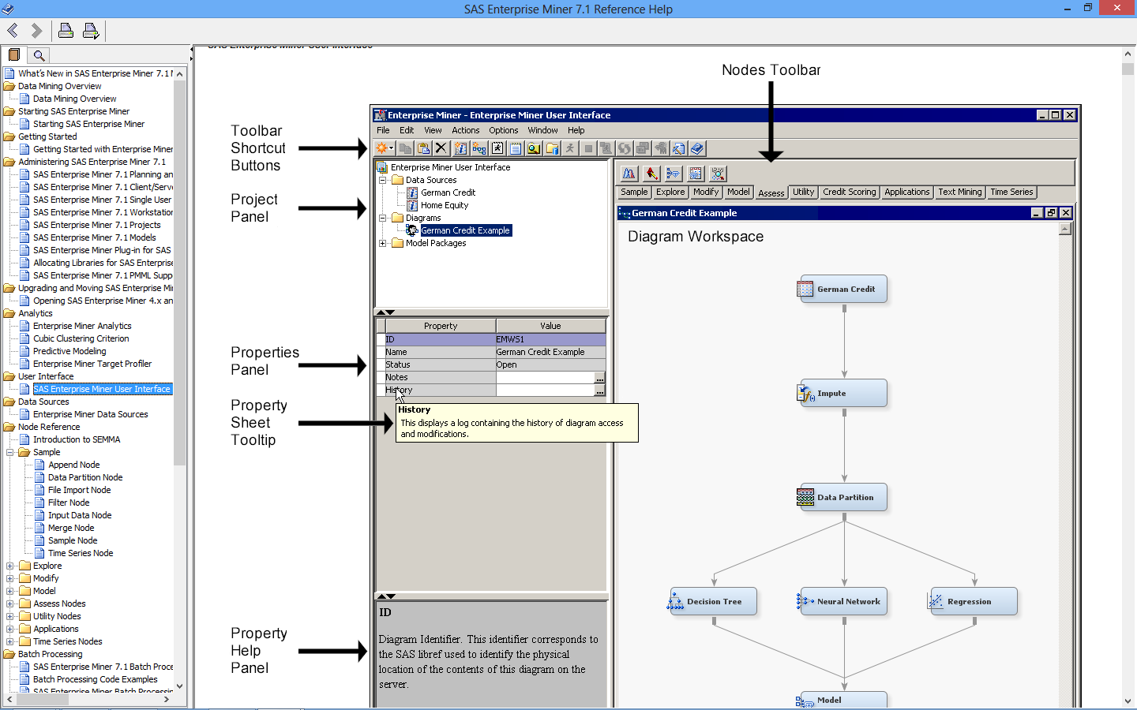
Eminer Graphical User Interface (GUI)
Source: EMiner help

Slide 4
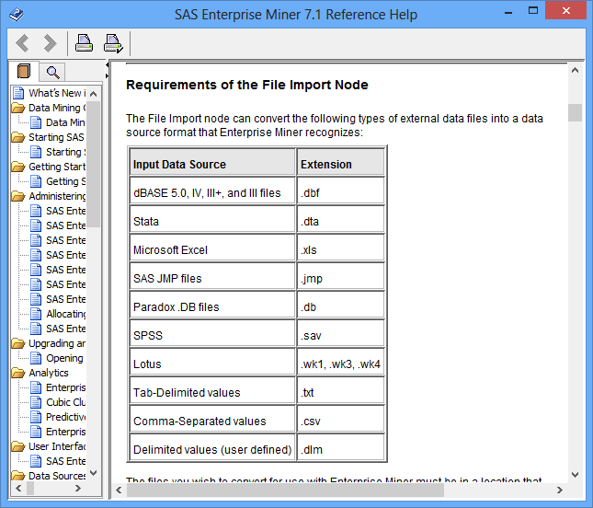
Accessing Sources of Data in EMiner
SAS Datasets
Other Types of Data:
Source: EMiner help

Slide 5
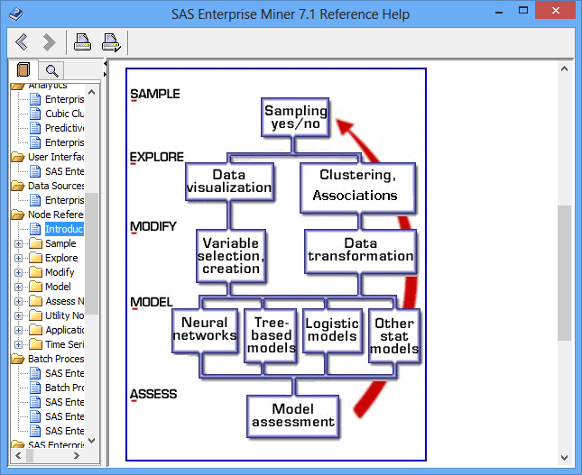
SEMMA Process (Note that EGuide and EMiner both can be used in all phases of SEMMA, but we will use the best tool for each task we do which usually means EGuide for data set up and Eminer for Modeling and Assessment.)
IBM use in
this course (blue)
EMiner use in
this course (red)
Source: SAS Enterprise Miner help

Slide 6
EMiner Data Source Roles
A data source appears in the Project Panel of the Enterprise Miner window. When a data source is selected, properties are displayed in the Properties Panel. See Data Source Properties for detailed information.
When you select a data source, use the Role property to change the role of a data source. The role of a data source determines how the data source is used throughout the process flow diagram. Select one of the following values:
Source: EMiner help

Slide 7
EMiner Data Source Roles
Raw (Default) — is used as raw input to a node.
Train — is used to fit initial models.
Validate — is used by default for model comparison, if available. The validate data source is also used for fine-tuning the model. The Decision Tree and Neural Network nodes have the capacity of overfitting the TRAIN data set. To prevent these nodes from overfitting the train data set, the validate data set is automatically used to retreat to a simpler fit than the fit based on the train data alone. The validate data set can also be used by the Regression node for fine-tuning stepwise regression models.
Test — is used to obtain a final, unbiased estimate of the generalization error of the model.
Score — is used to score a new data set that might not contain the target.
Transaction — is used in the Time Series and Path Analysis nodes. Transaction data is time-stamped data that is collected over time at no particular interval. If you do not have training, validation, and test data sets, then you can create them with a successor Data Partition node.
Source: EMiner help

Slide 8
Variable Model Roles in Eminer – Defines how Eminer uses the variable
Assessment — is generated by a modeling node. An assessment variable is used for model comparisons.
Censor — is a censor variable in survival analysis.
Classification — is generated by a modeling node. A classification variable contains the prediction for a categorical target variable.
Cost — is a variable that contains the decision costs for each observation in the input data set.
Cross ID — is a variable that contains groups or levels for cross-sectional analysis. This is an optional variable used in the Time Series node.
Decision — is a variable that contains information about the decision based on a predictive model.
Frequency — is a variable that represents the frequency of occurrence for other values in each observation. Unlike some SAS procedures, the frequency variable can contain noninteger values and can be used for weighting observations.
ID— an indicator variable for every observation in the data set. Observations with the same ID values form a transaction. The Association node requires an ID variable for association discovery. ID variables are normally excluded when analyzing the data with the other modeling nodes.
Input — is a variable that is used to predict the target. It is the independent or explanatory variable.
Label — is a variable that contains the text label.
Prediction — is a variable that contains the predicted values of the target.
Referrer — is used in the Path Analysis node. When you analyze Web data that a user visits site B from site A, site A is the referrer in this case.
Source: EMiner help

Slide 9
Variable Model Roles in Eminer - Defines how Eminer uses the variable
Rejected — a variable that is excluded from the analysis in the process flow diagram. If you know a variable that is not important in the analysis, set the model role of the variable to Rejected.
Residual — a variable that contains the residuals.
Segment — is a variable that identifies segment. The Clustering node creates a segment variable. The Text Miner node also generates a segment variable is clustering analysis is performed.
Sequence — is a variable that represents the time span from observation to observation. The Association node requires a sequence variable for sequence discovery. The sequence (time stamp) variable must be recorded on the same scale.
Target — is a variable whose value is known in some currently available data, but will be unknown in some future or fresh data. It is the dependent or response variable.
Text — is a variable that contains the text of documents or the path to the documents. The Text Miner node uses text variables.
Text Location — is a variable that is used by the Text Miner node. This variable indicates the complete path to the HTML files that is created by %tmfilter. This variable is not created if the destdir option is not used in the %tmfilter statement.
Time ID — is a variable that contains a time identifier, usually in SAS date, time, or datetime format. The Time Series node requires a timeid variable.
Treatment — is a variable that the NetLift node uses to identify a treatment..
Web Address — is a variable that is used by the Text Miner node. This variable indicates the complete path to the original file that %tmfilter processes.
Source: EMiner help

Slide 10
Measurement Levels (Attribute Types) in EMiner
The following measurement levels are available:
Binary — contains two discrete values (for example, PURCHASE: Yes, No).
Interval — contains values that vary across a continuous range (for example, TEMP: 0, 32, 34, 36, 50, 56, 80, ...., 102).
Nominal — contains a discrete set of values that do not have a logical ordering (for example, PARTY: Democrat, Republican, other).
Ordinal — contains a discrete set of values that do have a logical ordering (for example, GRADE: A, B, C, D, F).
Unary — contains one discrete value.
Source: EMiner help

Slide 11
How to Handle Missing Data?
Ignore the tuple: usually done when class label is missing (assuming the tasks in classification—not effective when the percentage of missing values per attribute varies considerably.
Fill in the missing value manually: tedious + infeasible?
Impute Node in EMiner - Fill in it automatically with
a global constant : e.g., “unknown”, a new class?!
the attribute mean
the attribute mean for all samples belonging to the same class: smarter
the most probable value: inference-based such as Bayesian formula or decision tree

Slide 12
EMiner Visualization
Graph Explore Node/Explore Button on Variables Window can produce the following plots:
Scatter Plots
Line Plots
Histograms
Density Plots
Box Plots
Tables
Matrix Plots
Lattice Plots
Parallel Axis Plots
Constellation Plots
3D Charts
Contour Plots
Bar Charts
Pie Charts
Needle Charts
Vector Plots
Band Plots

Slide 13
Handling Redundancy in Data Integration
Redundant data occur often when integration of multiple databases –Merge Node
Object identification: The same attribute or object may have different names in different databases
Derivable data: One attribute may be a “derived” attribute in another table, e.g., annual revenue
Redundant attributes may be able to be detected by correlation analysis
Careful integration of the data from multiple sources may help reduce/avoid redundancies and inconsistencies and improve mining speed and quality – some methods handle correlated variables better than others

Slide 14
Correlation Analysis (Numerical Data)
Correlation coefficient (also called Pearson’s product moment coefficient)
where n is the number of tuples, and are the respective means of A and B, σ_{A} and σ_{B} are the respective standard deviation of A and B, and Σ(AB) is the sum of the AB cross-product.
If r_{A,B} > 0, A and B are positively correlated (A’s values increase as B’s). The higher, the stronger correlation.
r_{A,B} = 0: independent; r_{A,B} < 0: negatively correlated
Stat Explore Node in Eminer / SAS Code Node Proc Corr

Slide 15
Correlation Analysis (Categorical Data)
Χ² (chi-square) test
The larger the Χ² value, the more likely the variables are related
The cells that contribute the most to the Χ² value are those whose actual count is very different from the expected count
Stat Explore Node in EMiner
Correlation does not imply causality
# of hospitals and # of car-theft in a city are correlated
Both are causally linked to the third variable: population

Slide 16
Chi-Square Calculation: An Example (See Slide notes for expected counts help)
In Stat Explore Node in EMiner – Must Declare Target Variable
Need at least 5 expected values in each cell (preferably more) for chi-square test
Χ² (chi-square) calculation (numbers in parenthesis are expected counts calculated based on the data distribution in the two categories)
Consult chi-square table with (rows-1)*(cols-1) = 1 degrees freedom. It is 10.28 at significance 0.001 and thus shows that like book type preference and gender are correlated in the group
 | male | female | Sum (row)
fiction | 250(90) | 200(360) | 450
Non-fiction | 50(210) | 1000(840) | 1050
Sum(col.) | 300 | 1200 | 1500
Notes:
Ratio of 300/1500 = 0.2 = 90/450 = 210/1050 which give the expected counts in column 1. E.g for the upper left cell, solve 300/1500 = x/450 to get x = 90. Do the same for the other cells to get the expected counts.
Ratıo of 1200/1500 = 0.8 = 360/450 = 840/1050 which give the expected counts in column 2.

Slide 17
Data Cube Aggregation
EMiner SAS Code Node – proc means
The lowest level of a data cube (base cuboid)
The aggregated data for an individual entity of interest
E.g., a customer in a phone calling data warehouse
Multiple levels of aggregation in data cubes
Further reduce the size of data to deal with
Reference appropriate levels
Use the smallest representation which is enough to solve the task

Slide 18
Attribute Subset Selection (Dimensionality Reduction)
EMiner Variable Selection Node (i.e., attribute subset selection):
Select a minimum set of features such that the probability distribution to remove irrelevant or redundant attributes
reduce # of patterns in the patterns, easier to understand
Heuristic methods – Options in some EMiner Nodes (e.g. regression nodes) (due to exponential # of choices):
Step-wise forward selection
Step-wise backward elimination
Combining forward selection and backward elimination

Slide 19
Data Transformation: Normalization – Transform Variables Node
Min-max normalization: to [new_min_{A}, new_max_{A}]
Ex. Let income range $12,000 to $98,000 normalized to [0.0, 1.0]. Then $73,000 is mapped to
Z-score normalization (or standardization) (μ: mean, σ: standard deviation):
Ex. Let μ = 54,000, σ = 16,000. Then
EMiner Transform Variables Node can do this as well as many other transforms
EGuide Standardize Task does Z-score standardization

Slide 20
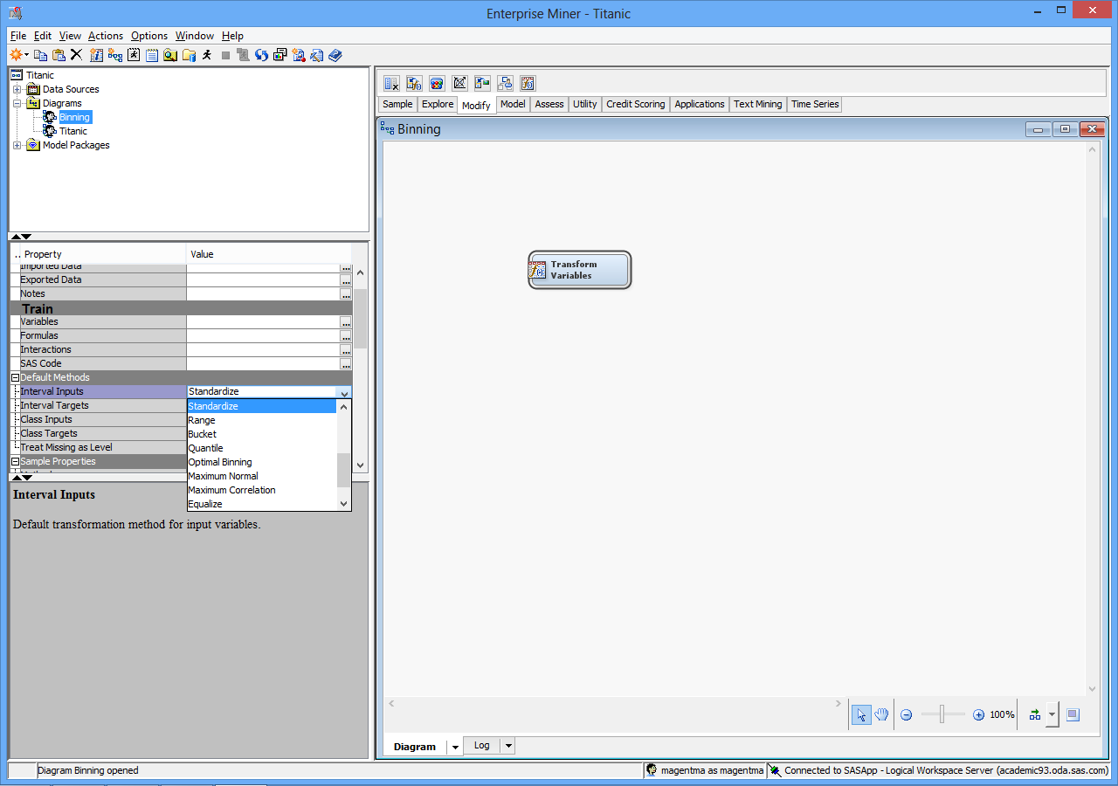
Z-score - Standardize is one default for the Transform Variable Node

Slide 21
Simple Discretization Methods: EMiner Interactive Binning Node
Equal-width (distance) partitioning (Bucket in EMiner)
Divides the range into N intervals of equal size: uniform grid
if A and B are the lowest and highest values of the attribute, the width of intervals will be: W = (B –A)/N.
The most straightforward, but outliers may dominate presentation
Skewed data is not handled well
Equal-depth (frequency) partitioning into quantiles (Quantile in EMiner)
Divides the range into N intervals, each containing approximately same number of samples
Good data scaling
Managing categorical attributes can be tricky

Slide 22
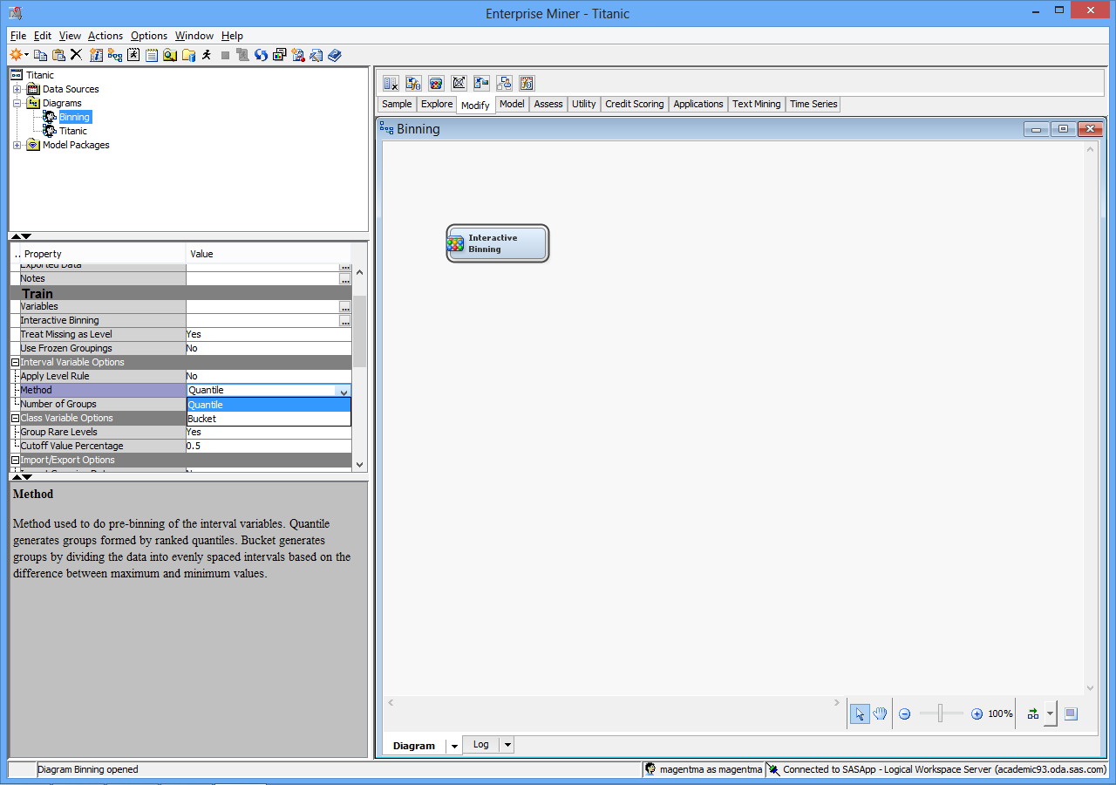
Interactive Binning Node pull-down allows selection of binning type

